Slide 2
Frozen Custard System Management
Using customized DBMS

Slide 3






1
Team 3 – Session 9:50 AM
The Original Frozen Custard– DBMS Course Project
Hummarah Shahzad
Avishek Dasgupta
Samarth Bansal
Siddhant Treasure
Mannat Singh
Kai

Slide 4
1
Agenda
Project Map
Original Frozen Custard– DBMS Course Project
1
Business Problem – defining business objectives for the project
2
Conceptual Design – developing ER diagram for the problem
3
Logical Design – developing relational schema from ERD
4
Normalization – ensuring logical design is in 4NF before SQL modeling
5
Implementing Database – creating database in SQL
6
Querying Database – developing queries to meet our business objectives
7
Business Insights – Business findings and way forward

Slide 5











1
Entities & Relationships
Business Problem
Our project aims to model a centralized data base for a local business using multiple sources of data to help management generate relevant insights for data driven business decisions
Employees–
Employees are responsible for selling products
Sales –
Products generate sales for the business
Raw material –
Each product is made using different raw materials
Expense–
Manufacturing selling and marketing expense along with running expenses are recorded
Products–
Products are offered by the business/employees to the customers
Marketing–
Each channel has a marketing expense
Vendors –
Raw materials are
provided by various
vendors
Objectives
Identify star selling products to ensure right marketing strategy in place
Employees Annual bonus with respect to yearly performance matrix
Multiple sorting parameters to improve inventory management

Slide 6
Designing DBMS
Designing DBMS

Slide 7
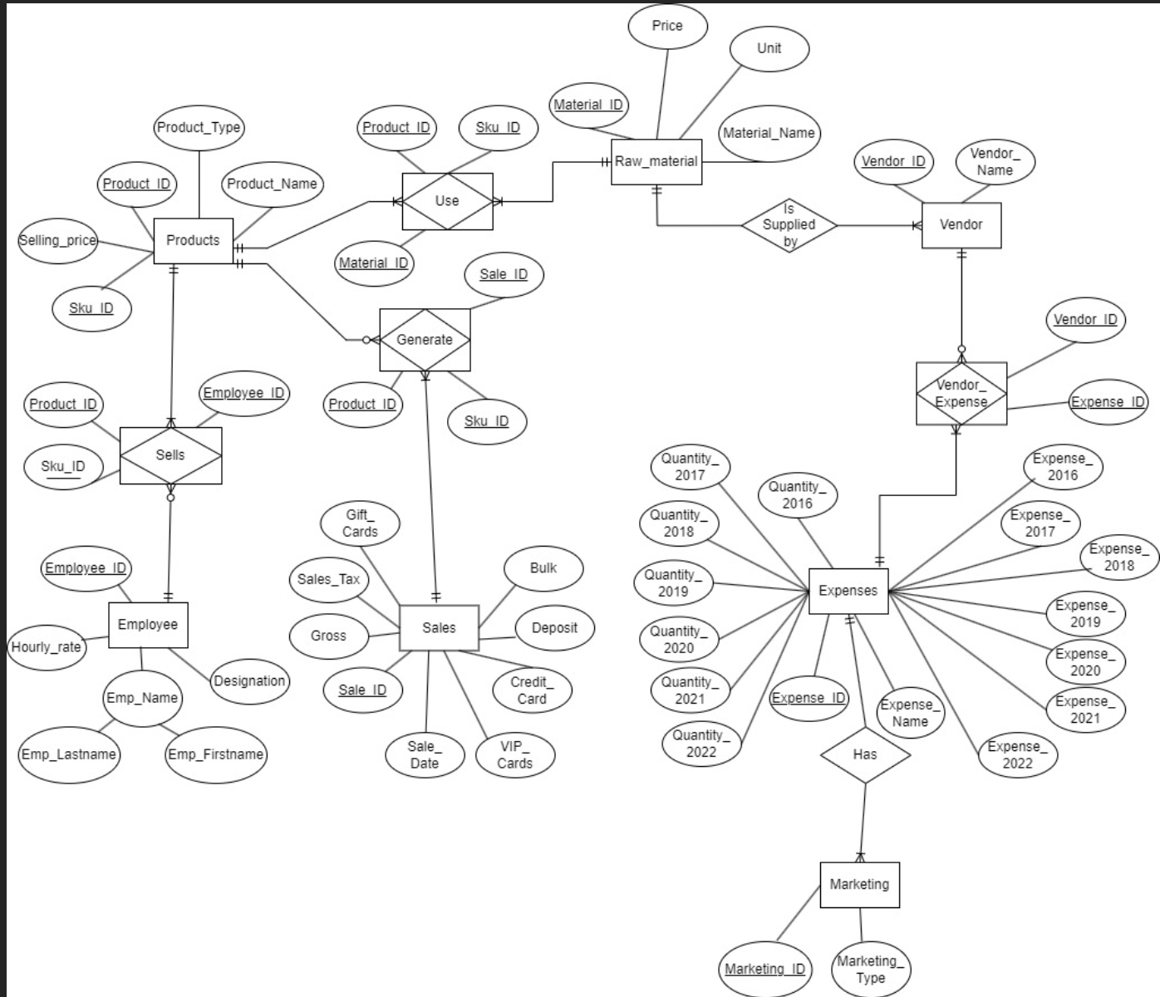



1
Entity Relationship Diagram
Conceptual Design
Developing entity relationship diagram for the problem
Relationship between Employees> Product > Sales> Raw material & Vendor & Expenses is a many-to-many relationship, we create three associative entity tables:
Employee-Product (Sells) –
Employee annual bonus
Product-Sales (Generate)–
Identify highest selling products
Product-Raw Material (Use)–
To optimize inventory level to meet product demand

Slide 8
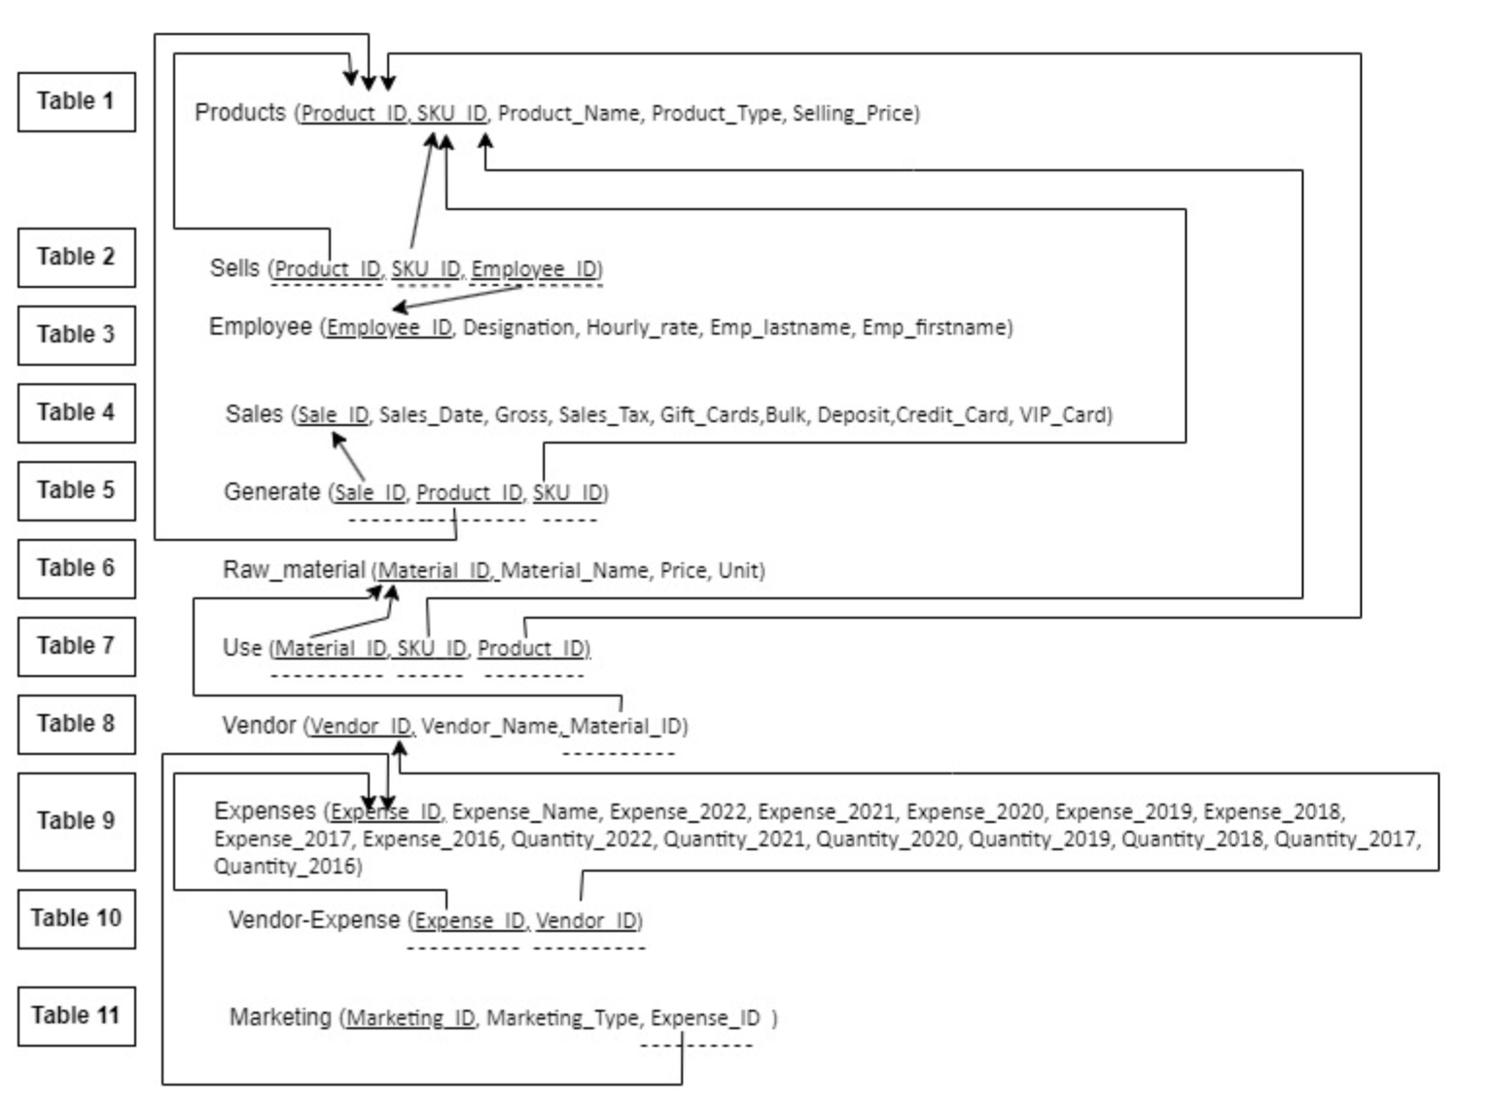
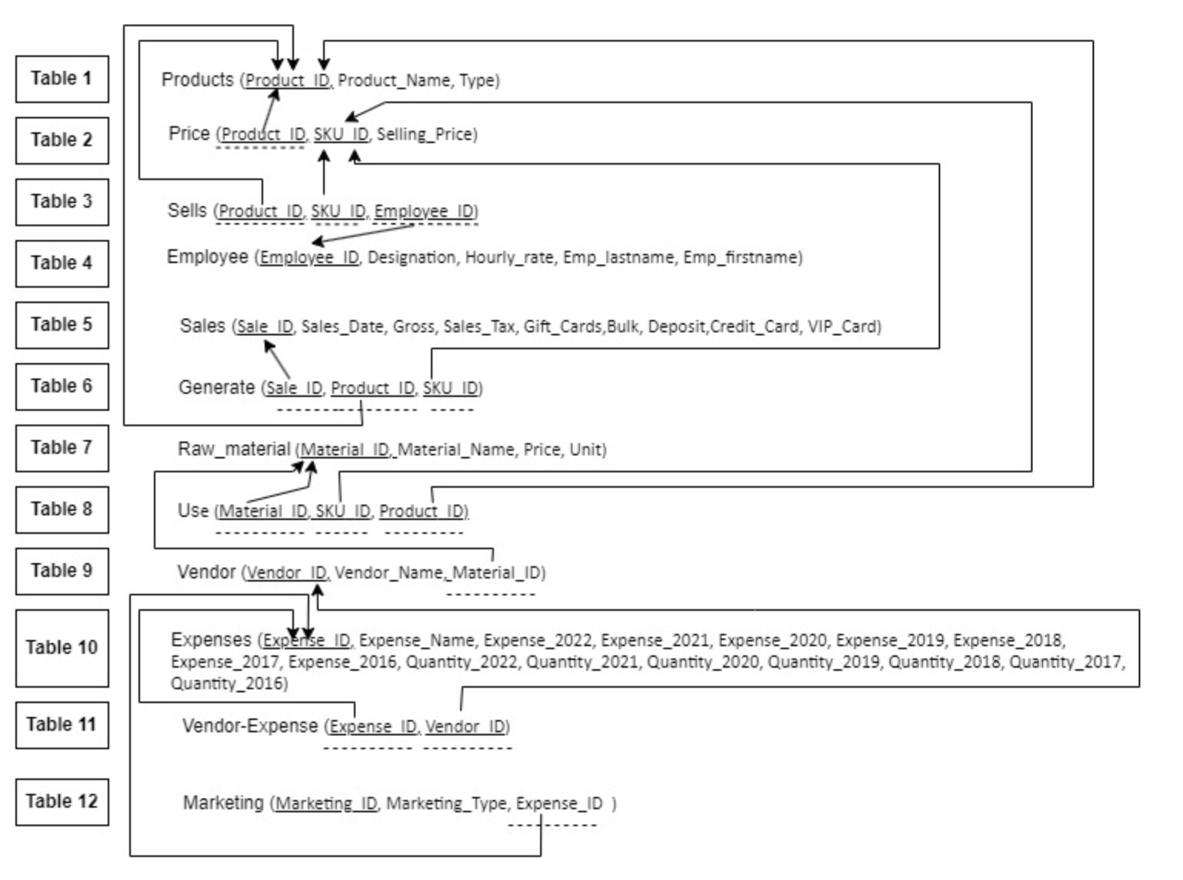
1
Relational Schema
Logical Design
Developing relational schema from ER diagram
Relational schema allows us to set the framework for implementation of our DBMS

Slide 9
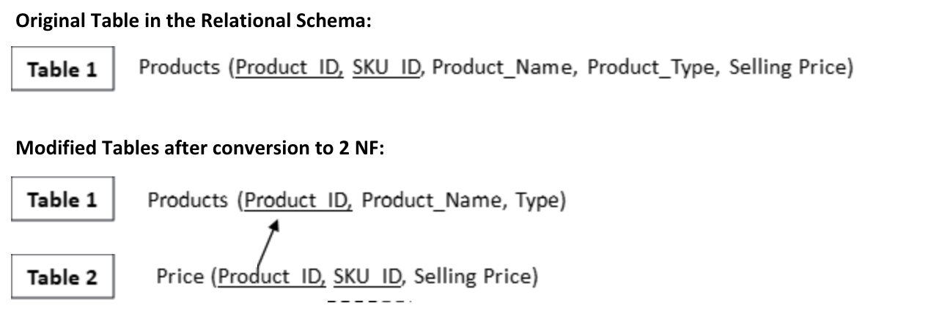
1
Entities in 3 NF
Normalization
Entities needs to be in 3NF before implementation
Validation for 1NF
Multi-valued or composite attributes?
No multi-valued or composite attributes.
Validation for 2NF
Partial dependencies in the data?.
It was found that Table 1 in the Relational Schema has partial dependencies. Therefore, Table 1 was split into 2 tables to remove the partial dependencies.
Validation for 3 NF:
Transitive Dependencies?
After modifying the Schema for 2 NF, the data available in all the tables were validated for 3NF. It was observed that the data is already in 3 NF, since no transitive dependencies were observed.

Slide 10
Implementing DBMS in SQL

Slide 11
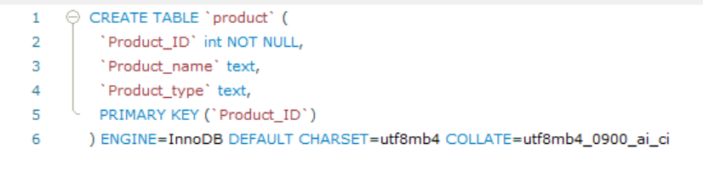
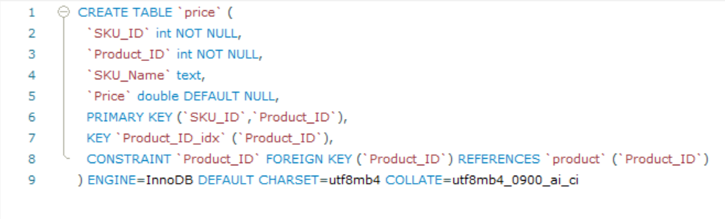
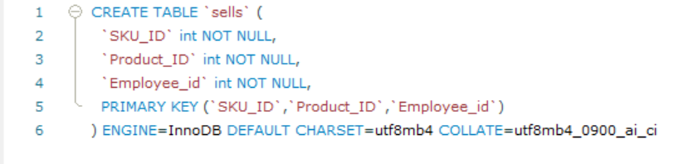
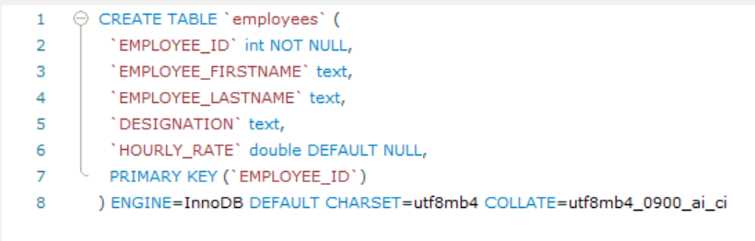
1
Implementation
Creating database in SQL
Using CREATE to generate entity tables
Using CREATE to generate associative entity tables

Slide 12
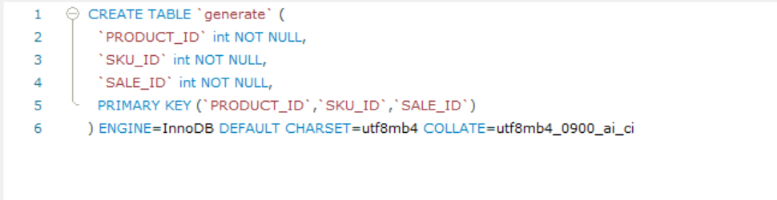
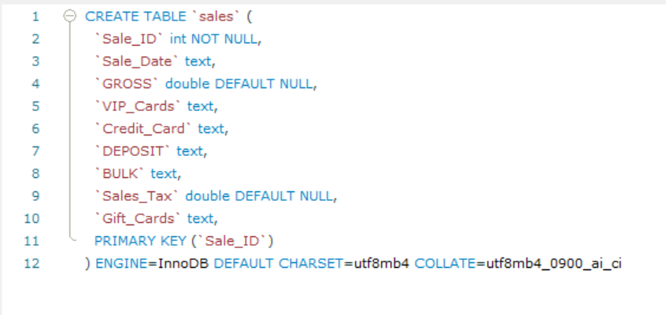
1
Implementation
Creating database in SQL
Using CREATE to generate entity tables
Using CREATE to generate associative entity tables

Slide 13
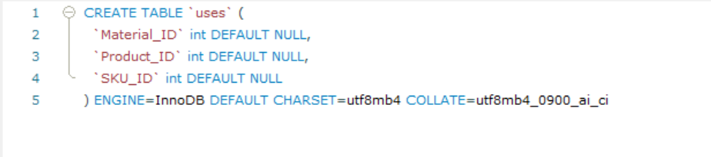
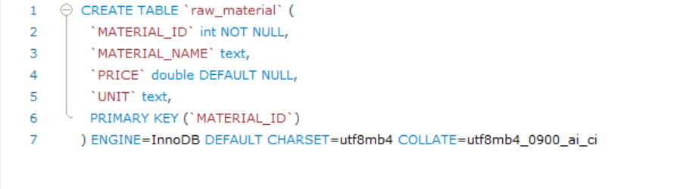
1
Implementation
Creating database in SQL
Using CREATE to generate entity tables
Using CREATE to generate associative entity tables

Slide 14
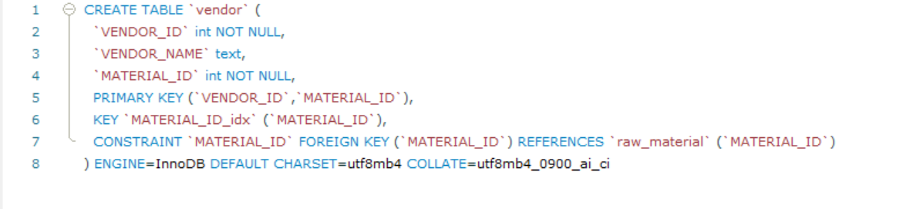
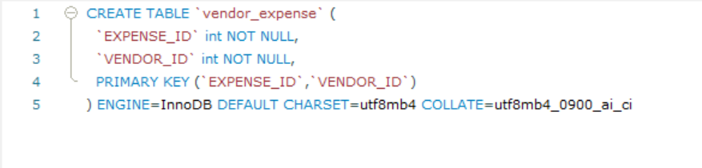
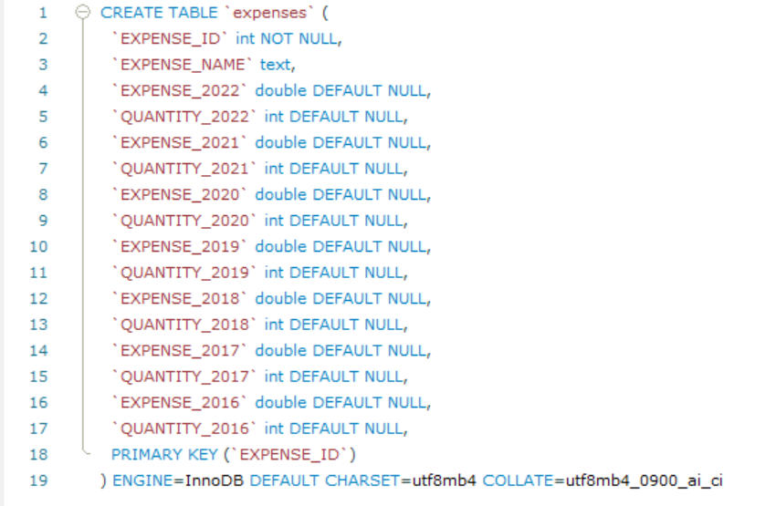
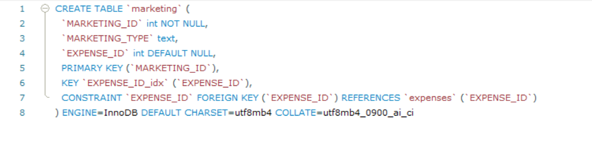
1
Implementation
Creating database in SQL
Using CREATE to generate entity tables
Using CREATE to generate associative entity tables

Slide 15
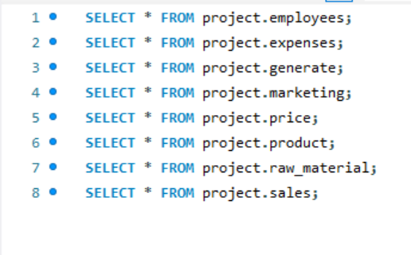
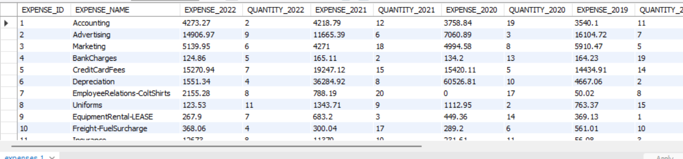
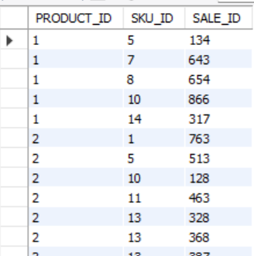
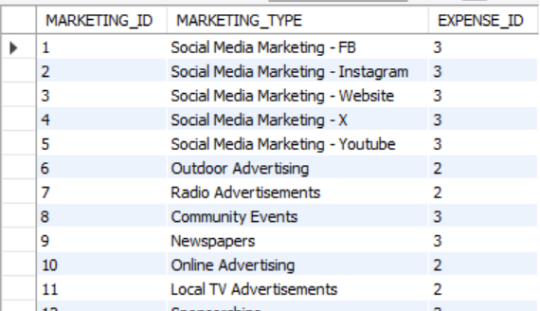
1
Implementation
Relational instance in database
Using SELECT to view corresponding tables

Slide 16
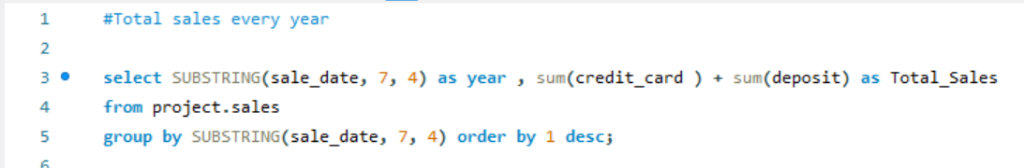
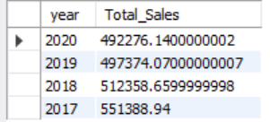

1
Querying the DBMS
Query Objective: show the total sales for year from 2017 to 2020
Business inferences from our database
Query
Output
The above output can act as a reference data to evaluate year on year total sales for the business and identify the year in which sales was the highest, this information can be further used to find out the contributors of high sales in the respective year

Slide 17
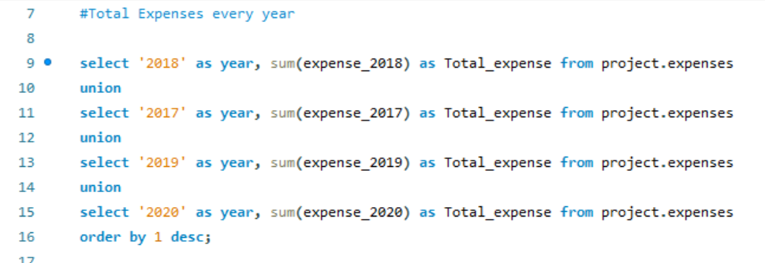
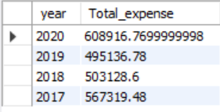
1
Querying the DBMS
Query Objective: show the total expense for all years from 2017 to 2020.
Business inferences from our database
Query
Output
This query helps us extract the total expense on an annual basis, we can further use the total output to select a year where we want to dig deeper into the expense table and understand where we can cut down on them

Slide 18
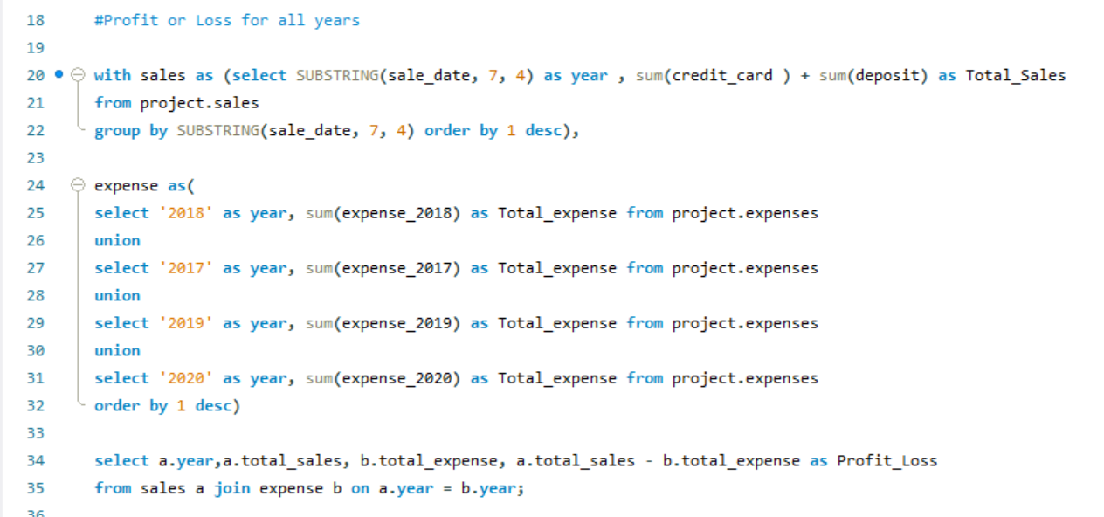
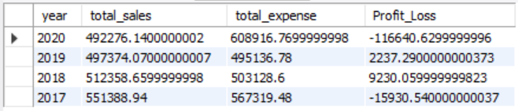
1
Querying the DBMS
Query Objective: show the profit or loss of each year from 2017 to 2020.
Business inferences from our database
Query
Output
In addition to the previous output, it is important to also know the bottom-line of the financials. The output not only gives data for profit/loss but also gives the corresponding revenue and expense for deeper reference

Slide 19
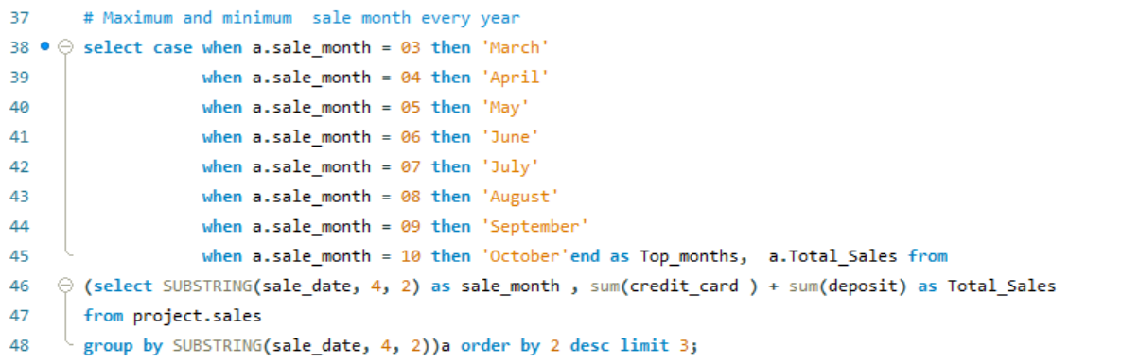
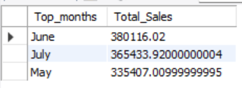
1
Querying the DBMS
Query Objective: To get the top highest selling months.
Business inferences from our database
Query
Output
Identifying three highest selling months could help in prioritizing marketing activities and manage inventory efficiently to meet the demand accordingly

Slide 20
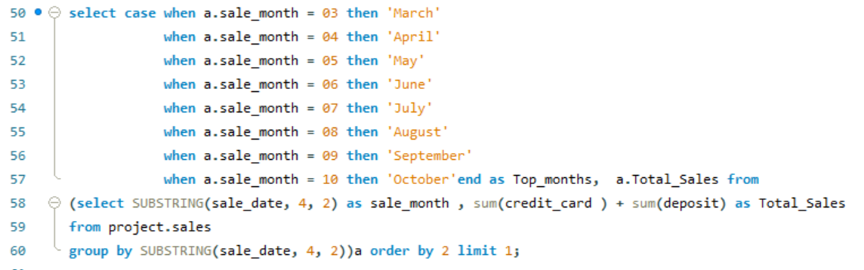
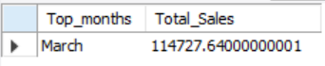
1
Querying the DBMS
Query Objective: give the lowest month and its sales.
Business inferences from our database
Query
Output
By identifying the lowest performing month using this query, the business can further dig deeper into the sales data and identify patterns to address low sales

Slide 21
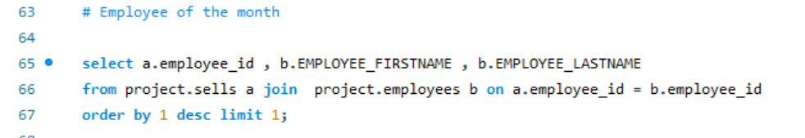
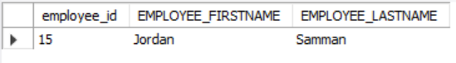
1
Querying the DBMS
Query Objective: to find the employee of the month based on the number of product sold each month
Business inferences from our database
Query
Output
Identifying 'Employee of the month' is a key component in employee management. Any incentive tied to performance could further encourage employees to strive for achieving this goal

Slide 22
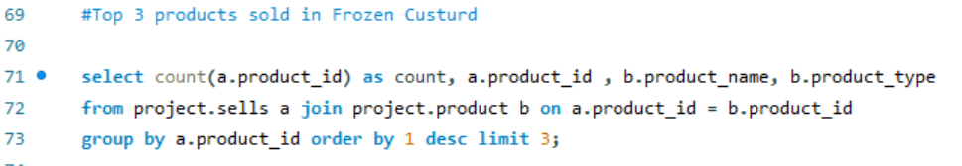
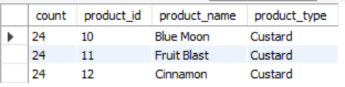
1
Querying the DBMS
Query Objective: To find the top 3 most sold products at Frozen Custard
Business inferences from our database
SQL Function
Output
Identifying top 3 selling products would help in managing inventory for flavors, prioritize product promotions and add bargaining leverage when negotiating with vendors

Slide 23
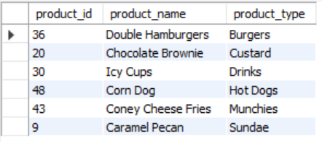
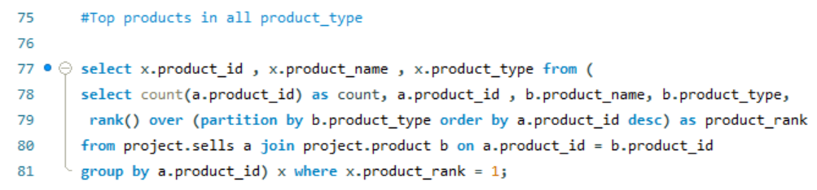
1
Querying the DBMS
Query Objective: To find the top products sold in all categories.
Business inferences from our database
SQL Query
Output
Identifying top products outside of the frozen custard menu would help in identifying products that complement well to the frozen custard menu and give inspiration for introducing new products as well

Slide 24
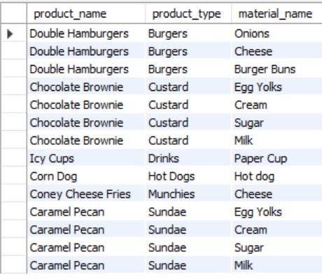
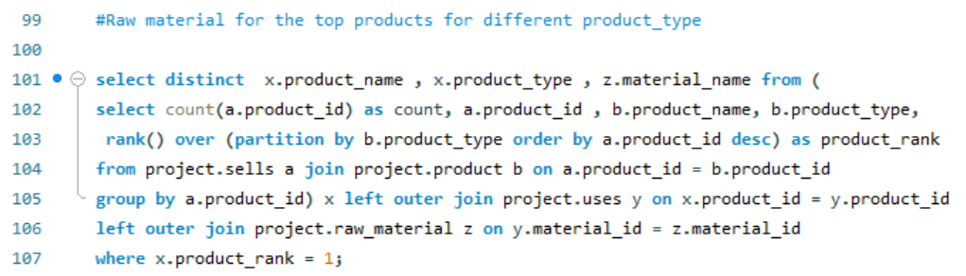
1
Querying the DBMS
Query Objective: To find the raw materials used for most sold products in all categories
Business inferences from our database
SQL Query
Output
This query is crucial for inventory management of other products as these products are not the primary selling items for the business and mismanagement of inventory could lead to unwanted expenses

Slide 25
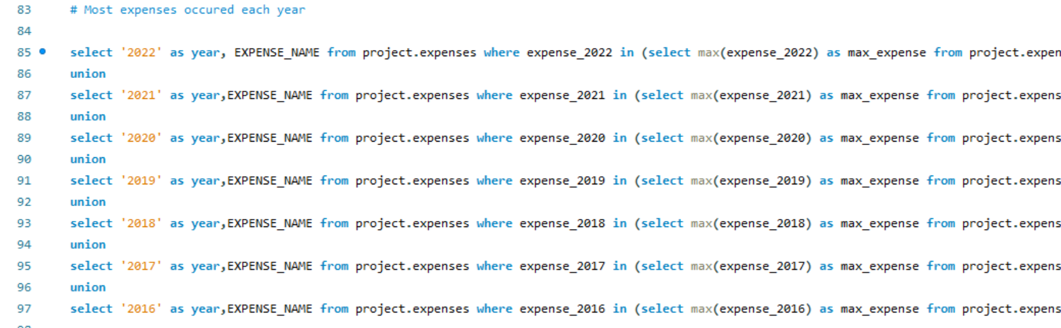
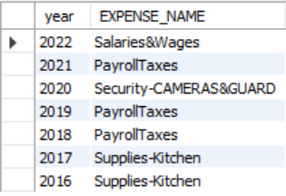
1
Querying the DBMS
Query Objective: To find the highest expenses occured in each year
Business inferences from our database
Query
Output
As a seasonal business it is important to have a track of expenses. The output from this query would help in identifying the area that costs the business the most

Slide 26





1
Business Findings
Business Recommendations
All business findings
Use the employee data in the database to create efficient work schedules and monitor performance. Implement training and development programs based on employee data to enhance skills and customer service
Monitor and analyze expense data to identify areas for cost savings and efficiency improvements. Regularly review operational expenses and vendor contracts to optimize spending
Utilize sales data to tailor marketing campaigns and promotions. Implement email marketing, social media engagement, and loyalty programs to attract and retain customers
At later stages, implement a CRM system within the database to integrate and track customer interactions on online and offline channels. This will enable personalized marketing campaigns, loyalty programs, and targeted promotions.
Provide ongoing training and support to staff members responsible for using the database. Encourage feedback from employees and customers regarding the database system's usability and functionality. Continuously improve the system based on user input

Slide 27

THANK YOU!

